Slide 1
Stream-3 Project
Prodyut Roy
Project Idea:
Identify and investigate optimal farm location where crop production yield is low and has repetitive low yield tendency
Project Data:
Yield data source : Manitoba Agricultural Services Corporation
Location: Municipalities in Manitoba
Data Collected Years: 2004 to 2023
Crop Case Investigate: ARGENTINE CANOLA

Slide 2
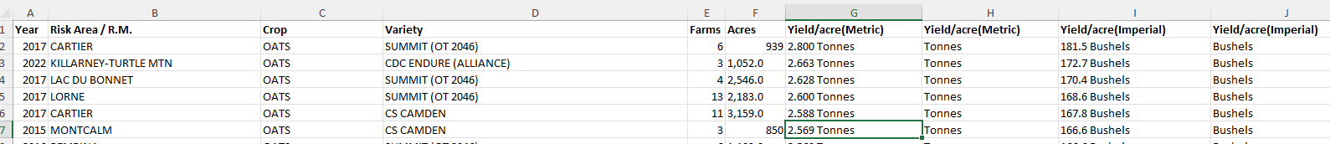
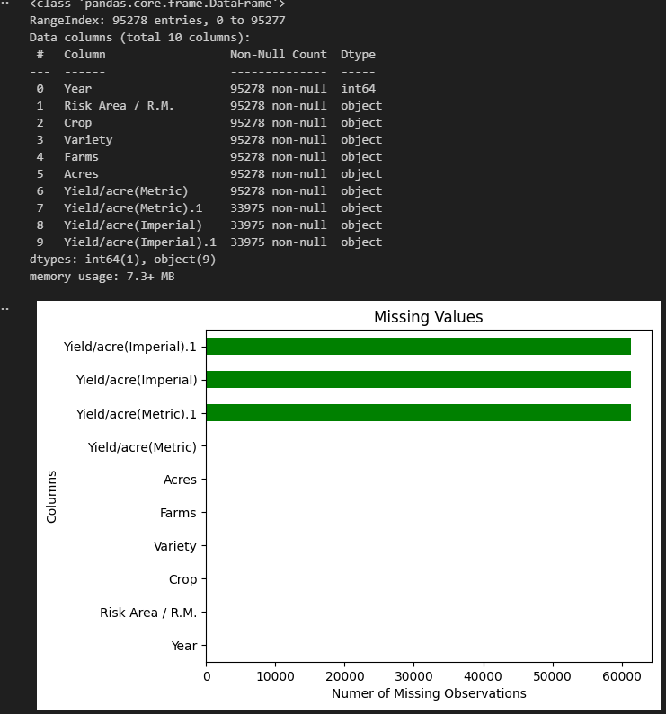
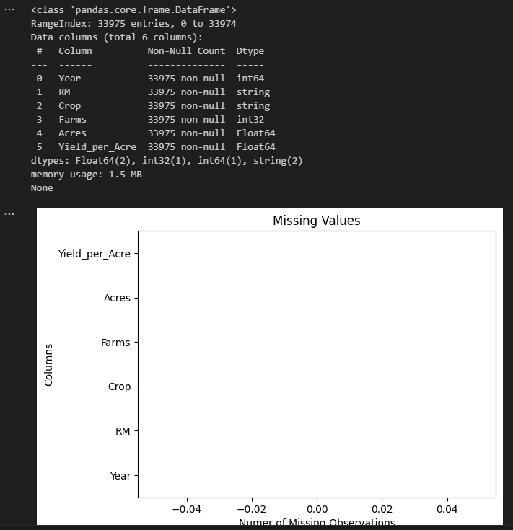
Raw Data Cleaning:
After Cleaning

Slide 3
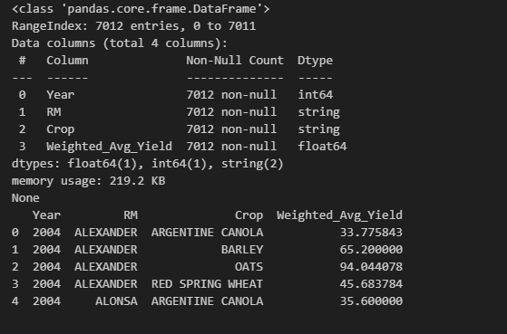
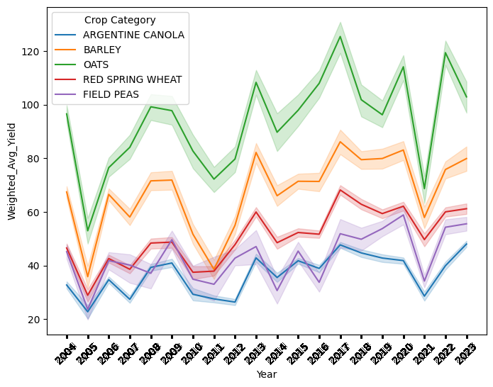
ETL
Transformed Clean data by applying groupby['Year','RM','Crop’] function and calculated Weighted Average Production Yield

Slide 4
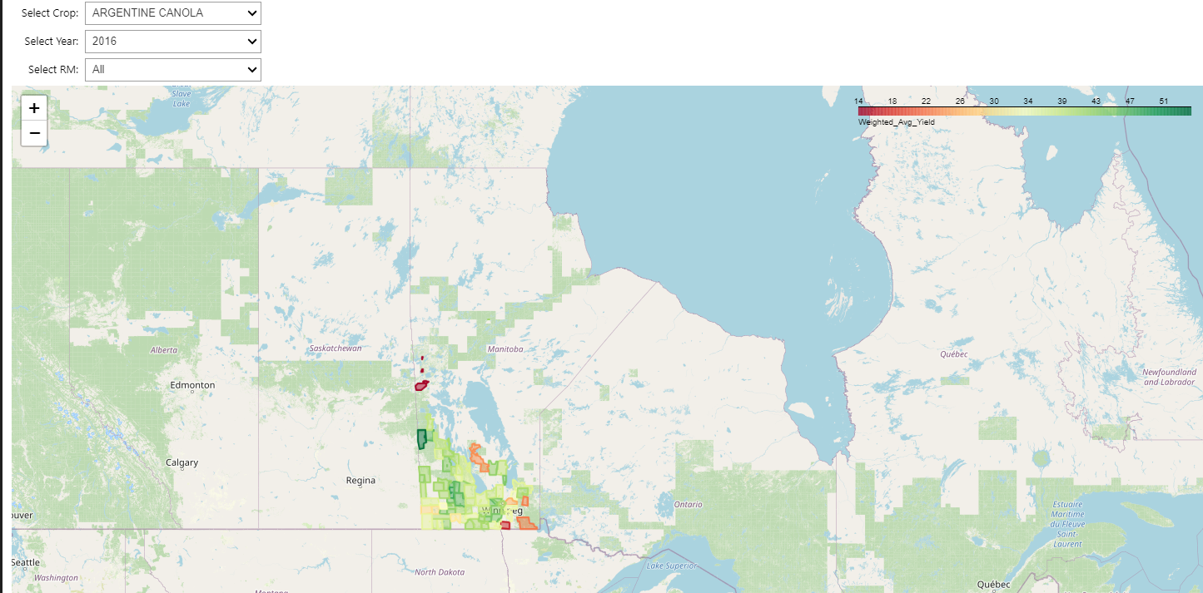
GIS Visualization

Slide 5
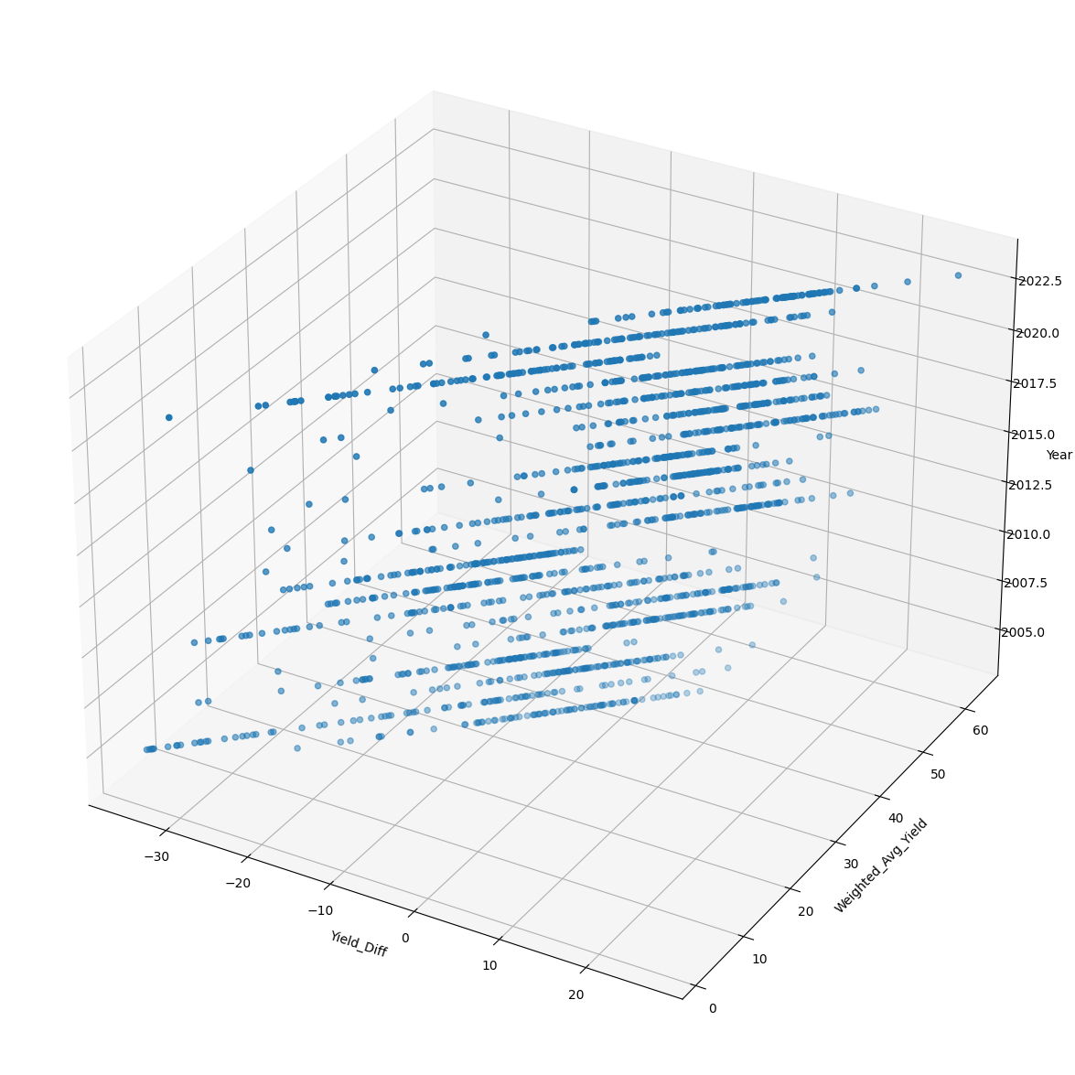
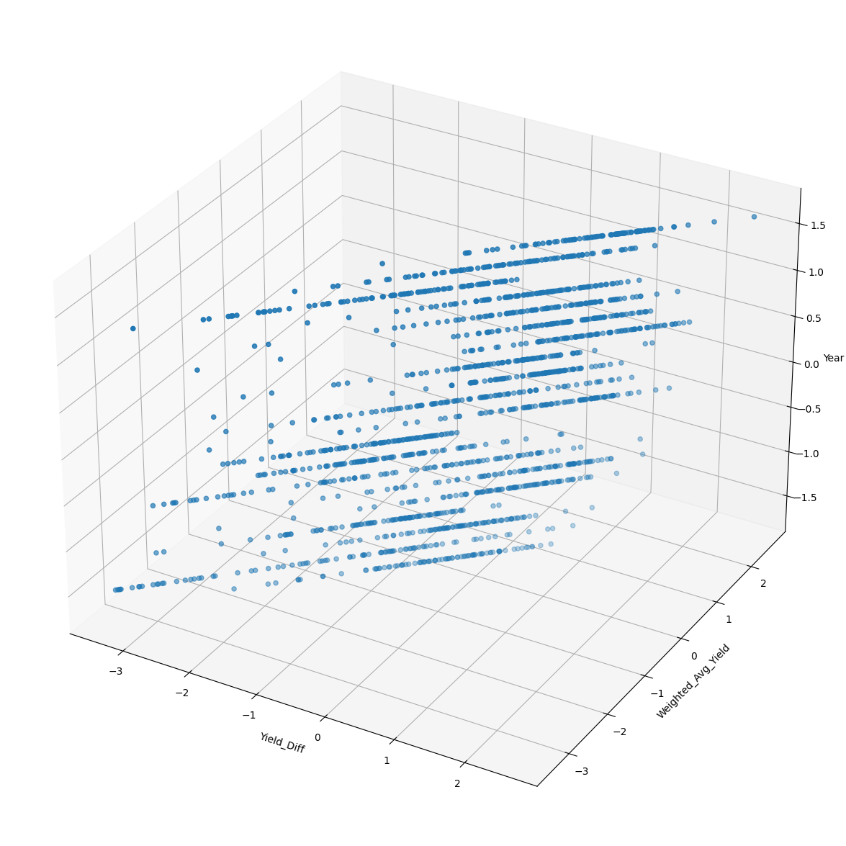
Data Analysis
Standard Canola Production Yield per Acre = 36.9
['Crop']=="ARGENTINE CANOLA"]
With Standard Scaler()
Without Scaling

Slide 6
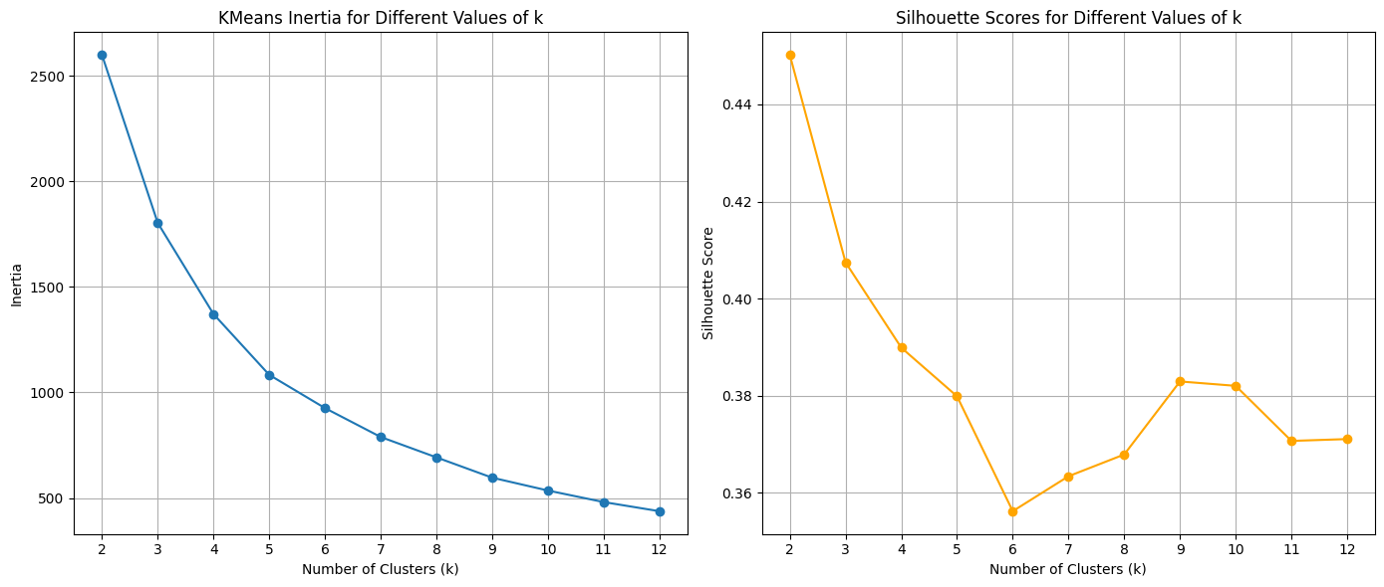
KMeans Clustering (Feature Engineering)

Slide 7
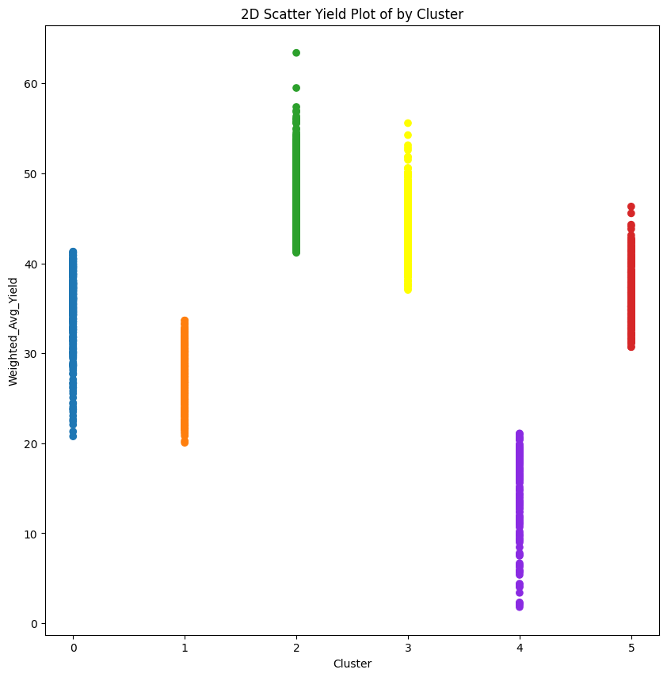
Model Training
kmeans = KMeans(n_clusters=6, random_state=42, max_iter=1000)
Labels for Clusters:
Cluster 4 : Low Yield Zone
Cluster 0, 1, 5 : Average Yield Zone
Cluster 2, 3 : High Yield Zone
Cluster 2, 3 : High Yield
Cluster 0,1,5: Average Yield
Cluster 4: Low Yield

Slide 8
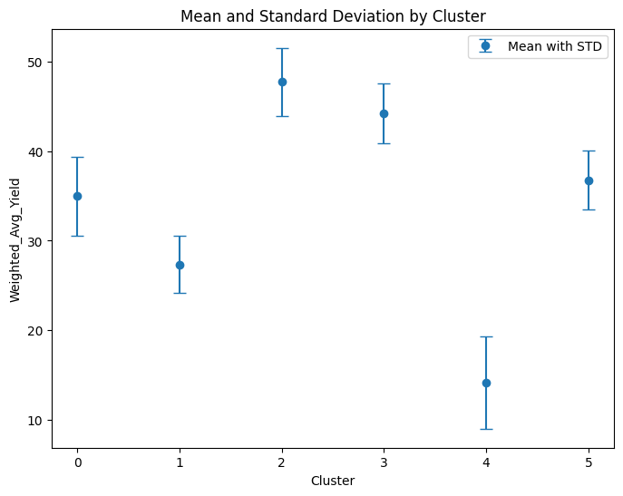
Cluster Details

Slide 9
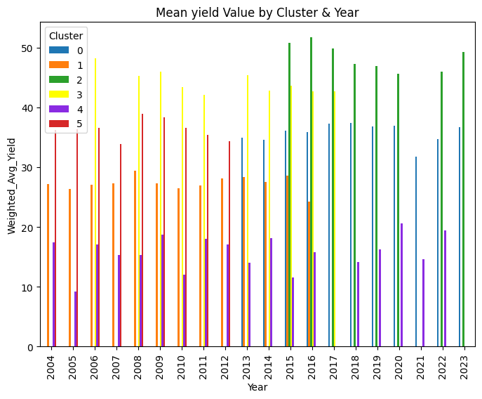
Cluster by Years

Slide 10
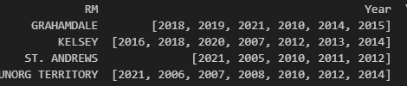
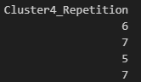
Investigate Low Yield Zone
Cluster 4 Low Production Zone
['Cluster’] == 4]
Identify Cluster 4 by RM and its repetition over Year 2004 to 2023
List Cluster 4 Repetition : Group by RM & Year
['Cluster4_Repetition']>4]

Slide 11
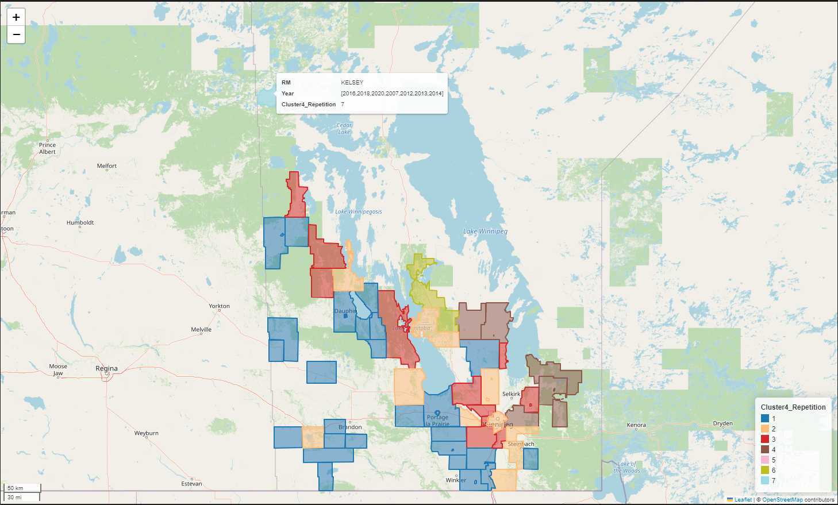
GIS View: Cluster 4 Low Production yield Repetition

Slide 12
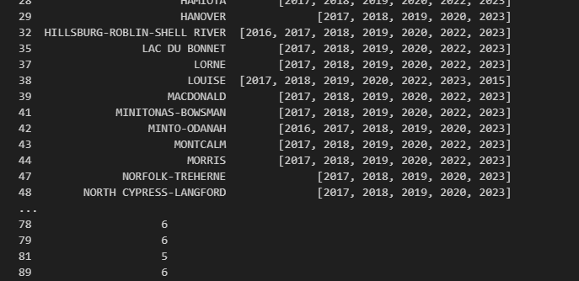
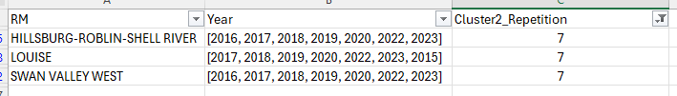
Investigate High Yield Zone
Cluster 2 High Production Zone
['Cluster’] == 2]
List Cluster 2 Repetition : Group by RM & Year
['Cluster 2_Repetition’] > 4]

Slide 13
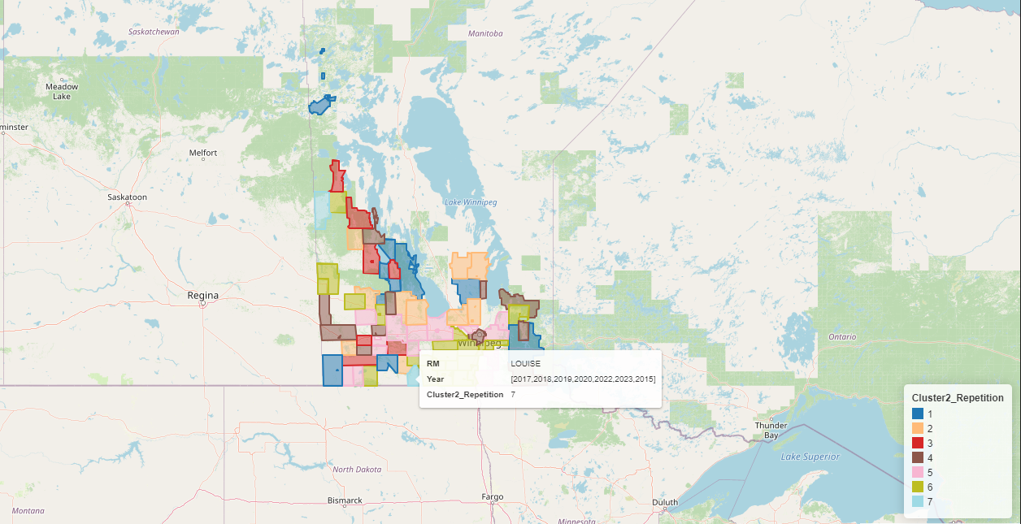
GIS View: Cluster 2 High Production yield Repetition

Slide 14
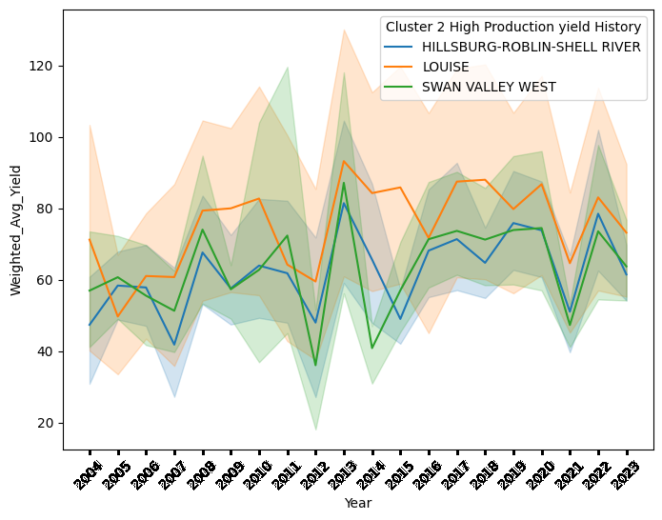
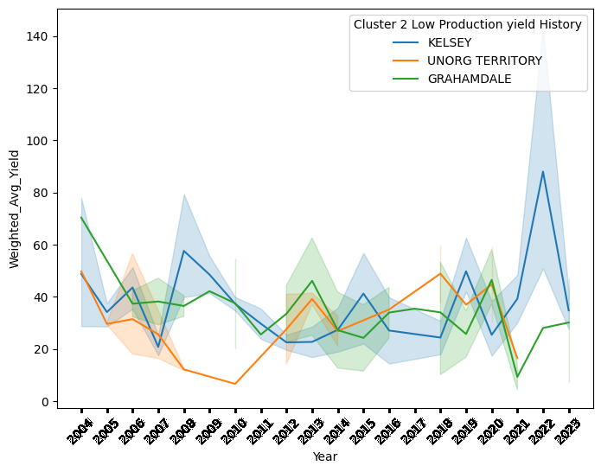
Year by Year Comparison : Picked 3 RM from Cluster 2 and 4
Cluster 2
Cluster 4
Max Low Yield Repetition : 07
Max High Yield Repetition : 07

Slide 15
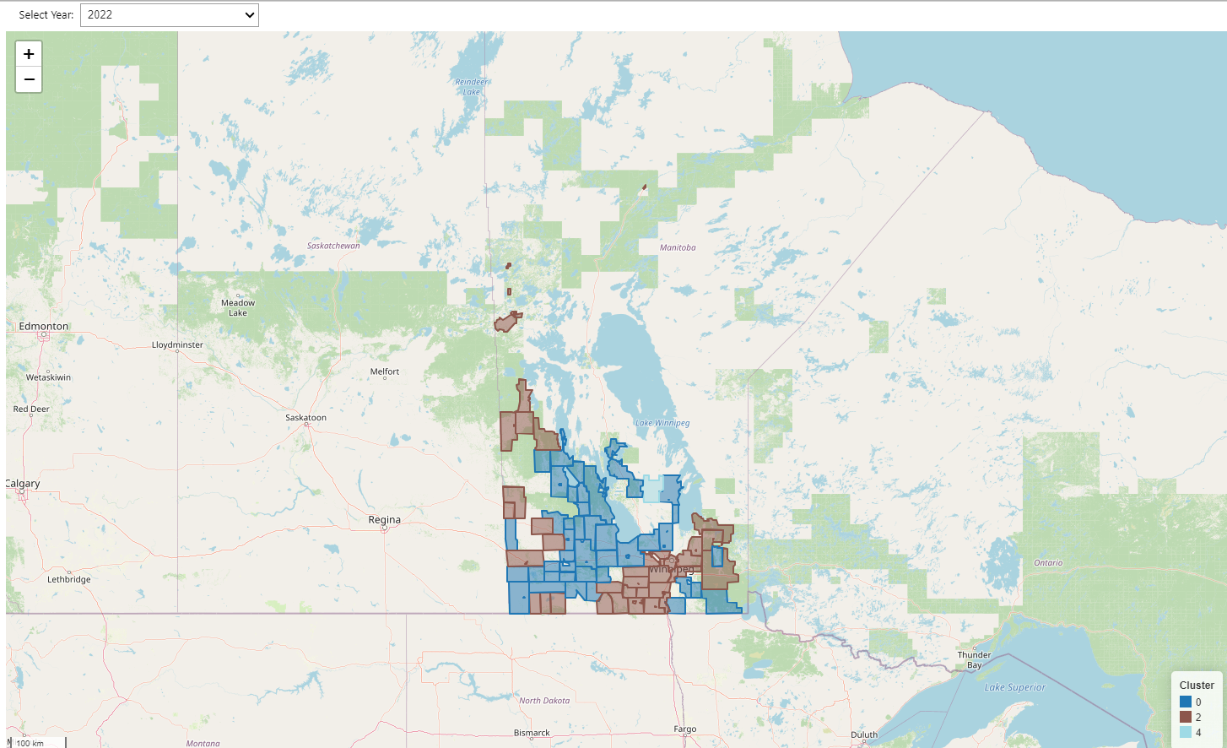

Slide 16
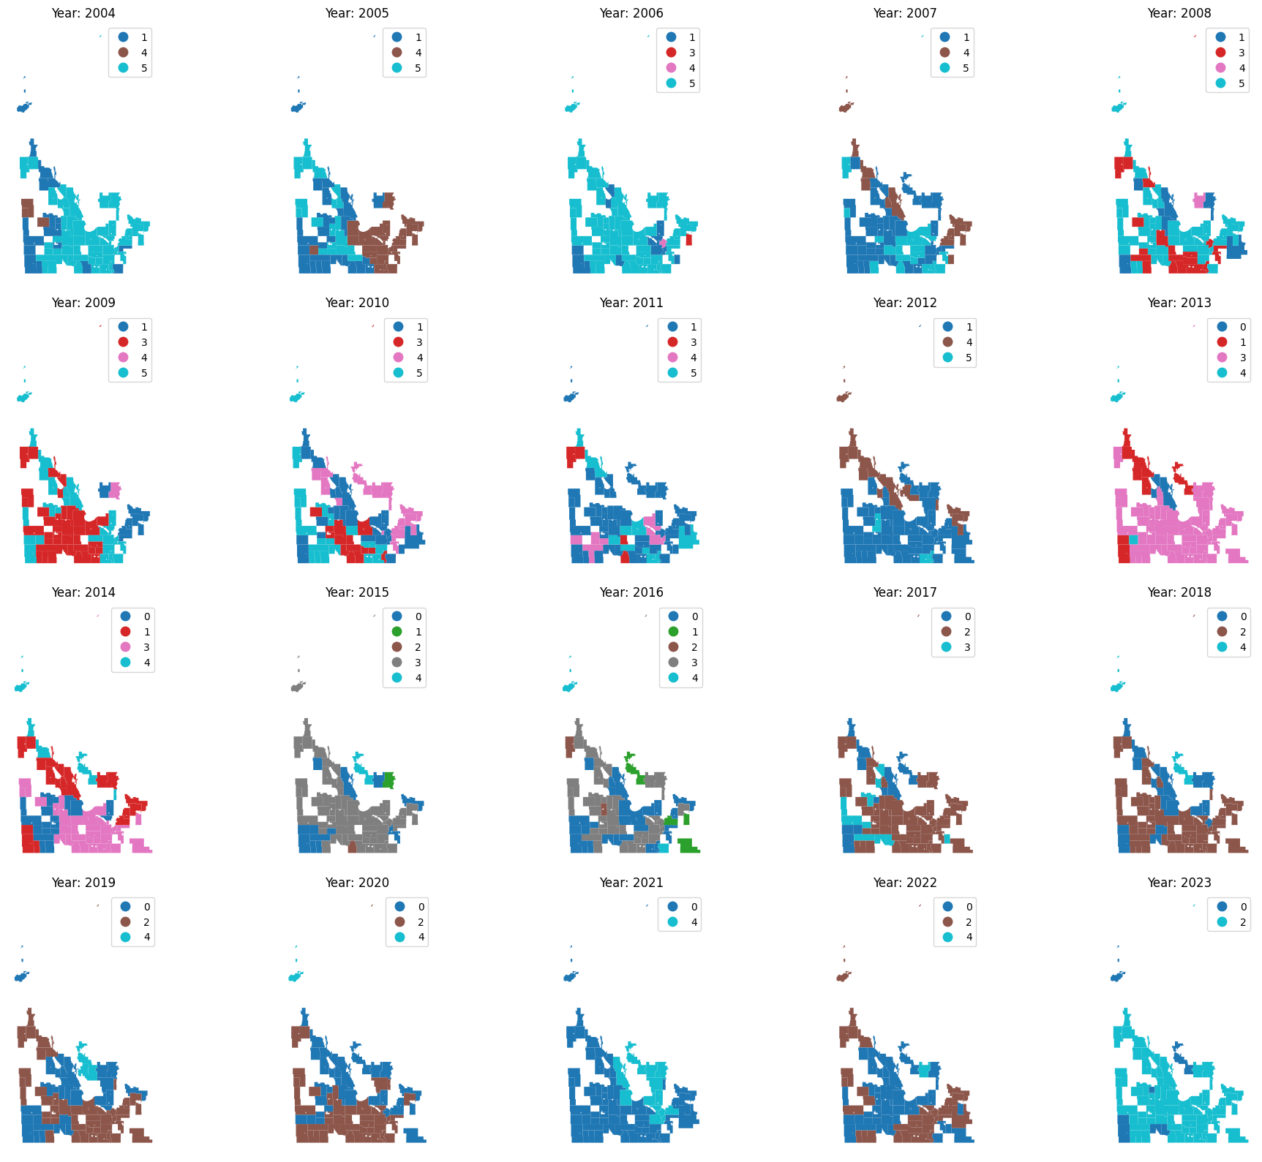

Slide 17
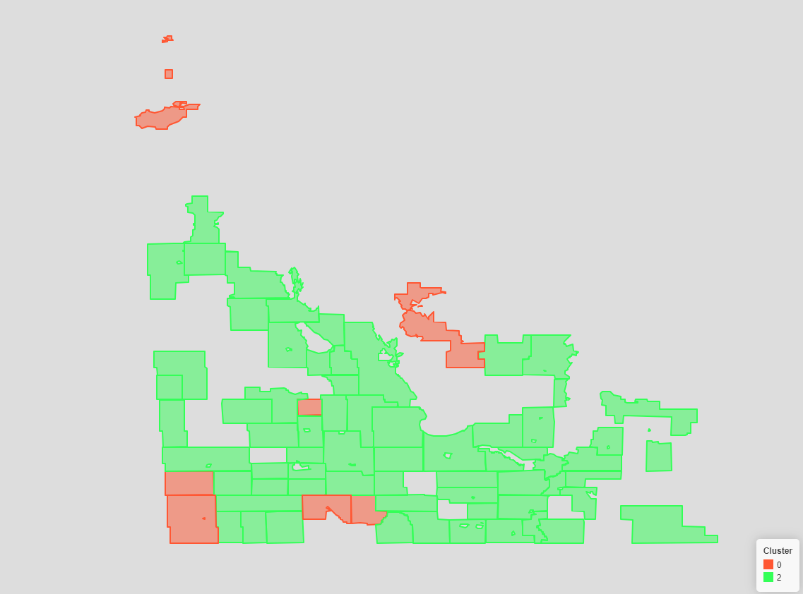
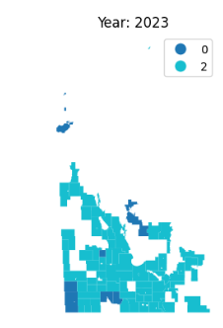
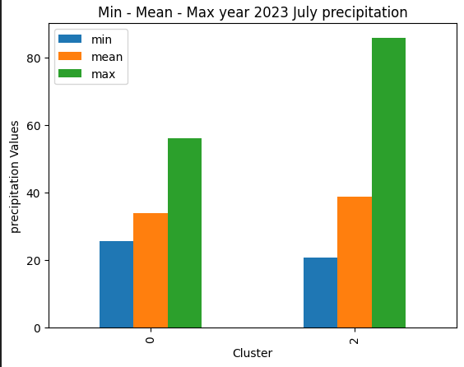
Investigate Yield with Precipitation (July 2023 Data)

Slide 18
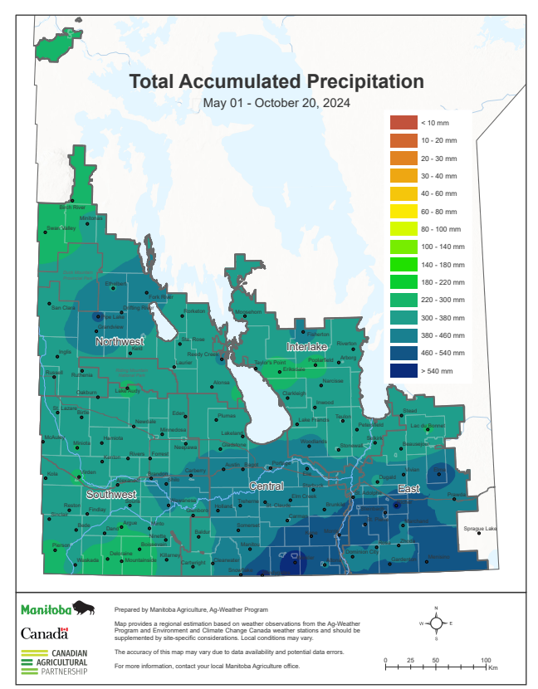

Slide 19
Conclusion
Need more Precipitation Data for further investigation

